Slide 1

Capstone Project: Funnels
Learn SQL from Scratch
Samantha Pita
January 3, 2019

Slide 2
TABLE OF CONTENTS
Part I: Warby Parker’s Survey Funnel
Part II: The People Have Spoken… Analyzing Response Data
Part III: A/B Testing with Home Try-On Funnel

Slide 3
Part I: Warby Parker’s
Survey Funnel

Slide 4
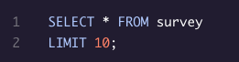
1.1 What is a Marketing Funnel?
In the context of marketing analysis, a funnel is a theory or diagram of how a customer travels towards the purchase of a product or service. Warby Parker, an innovative designer eyewear brand, uses a Style Quiz to steer new customers towards a purchase. The customers answer 5 questions, and all of their responses get stored into a database table called survey.
To get an idea of what columns exist in the survey table, I wrote the following query:
The results are on the following slide.

Slide 5
1.2 Query Results
question | user_id | response
1. What are you looking for? | 005e7f99-d48c-4fce-b605-10506c85aaf7 | Women's Styles
2. What's your fit? | 005e7f99-d48c-4fce-b605-10506c85aaf7 | Medium
3. Which shapes do you like? | 00a556ed-f13e-4c67-8704-27e3573684cd | Round
4. Which colors do you like? | 00a556ed-f13e-4c67-8704-27e3573684cd | Two-Tone
1. What are you looking for? | 00a556ed-f13e-4c67-8704-27e3573684cd | I'm not sure. Let's skip it.
2. What's your fit? | 00a556ed-f13e-4c67-8704-27e3573684cd | Narrow
5. When was your last eye exam? | 00a556ed-f13e-4c67-8704-27e3573684cd | <1 Year
3. Which shapes do you like? | 00bf9d63-0999-43a3-9e5b-9c372e6890d2 | Square
5. When was your last eye exam? | 00bf9d63-0999-43a3-9e5b-9c372e6890d2 | <1 Year
2. What's your fit? | 00bf9d63-0999-43a3-9e5b-9c372e6890d2 | Medium
By looking at 10 sample quiz responses, you can see that there are 3 columns:
question: This column displays which of the 5 questions the row of data is referring to
user_id: This column shows us which user answered by displaying the user’s unique identifying number
response: This column displays the user’s response
Warby Parker can learn a lot about what type of glasses people are looking for by looking at these results as a whole.

Slide 6
Part II:
The People Have Spoken…
Analyzing Response Data

Slide 7
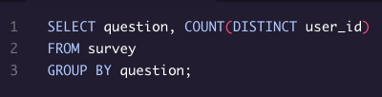
2.1 Quiz Response Rates
One of the very first things Warby Parker probably wants to know is, “How many responses does each question have?”.
In relation to SQL, this means we want to find out the total number of responses by unique users (we use the COUNT and DISTINCT commands here) for each question. We also sort our results by question using the GROUP BY command.
The query I used to find this information is to the right.
The results are below:
question | COUNT(DISTINCT user_id)
1. What are you looking for? | 500
2. What's your fit? | 475
3. Which shapes do you like? | 380
4. Which colors do you like? | 361
5. When was your last eye exam? | 270
You can see that the number of responses declines with each question. This shows that customers are giving up and falling off the funnel at different points in the quiz.

Slide 8
2.2 Sniffing Out Questions with Low Completion
Which questions lose the most potential customers?
This is important because Warby Parker will want to adjust or remove any questions that seem to derail a lot of quiz takers. So, we want to find out which questions have the lowest completion rates. Let’s look at the table from the previous slide showing the number of responses for each question (table, top right).
How do we calculate completion rates?
Using simple arithmetic, I divide the # of people completing each step by the # of people completing the previous step. The # of people who responded to the first question will start at 100%, because we haven’t lost anyone yet. The results of each question’s completion rates are shown here (table, bottom right).
question | COUNT(DISTINCT user_id)
1. What are you looking for? | 500
2. What's your fit? | 475
3. Which shapes do you like? | 380
4. Which colors do you like? | 361
5. When was your last eye exam? | 270
question | completion rate
1. What are you looking for? | 100%
2. What's your fit? | 95%
3. Which shapes do you like? | 80%
4. Which colors do you like? | 95%
5. When was your last eye exam? | 75%

Slide 9
2.3 Low Completion Results
Results
Our results show that Questions 3 and 5 have the lowest completion rates.
Analysis
Question 3: “Which shapes do you like?” My inference as to why this question has a low completion rate is that people do not know what shapes they are looking for yet. They may feel uncomfortable making a decision until they see examples of what’s available first. Perhaps they just don’t want to pigeonhole themselves into a particular shape yet.
Question 5: “When was your last eye exam?” I assume that people defer from answering this question because they do not remember when their last eye exam was. I can relate because as I get older, it seems that time to escape from work to go to the eye doctor becomes less and less of a priority. If people are ashamed that they don’t remember their last eye exam, they may get discouraged and leave the quiz.
question | COUNT(DISTINCT user_id)
1. What are you looking for? | 500
2. What's your fit? | 475
3. Which shapes do you like? | 380
4. Which colors do you like? | 361
5. When was your last eye exam? | 270
question | completion rate
1. What are you looking for? | 100%
2. What's your fit? | 95%
3. Which shapes do you like? | 80%
4. Which colors do you like? | 95%
5. When was your last eye exam? | 75%

Slide 10
Part III:
A/B Testing with
Home Try-On Funnel

Slide 11
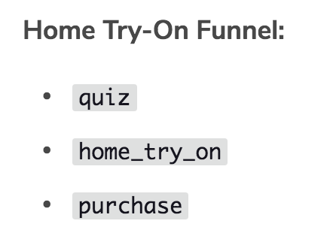
3.1 Introduction to A/B Testing
A/B testing is a method of comparing two versions of a single variable. The control is the original element that is currently in use. The variant is the new version that will be tested out in comparison against the original.
Let’s say Warby Parker is analyzing their Home Try-On Funnel:
Warby Parker wants find out whether or not users who get more pairs of glasses to try on at home will be more likely to make a purchase. The variable being tested here is the number of glasses you get to try on at home.

Slide 12
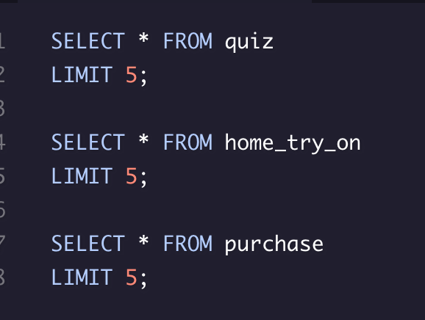
3.2 Testing Our Variables
Variable 1: 50% of users will get 3 pairs of glasses to try on at home
Variable 2: 50% of users will get 5 pairs of glasses to try on at home
We currently have different tables for each step in the funnel. We are going to have to combine these into one data set to see the results of our A/B testing. Let’s start by seeing what we’re tables we’re working with by using the following query:
The query results are on the following slide.

Slide 13
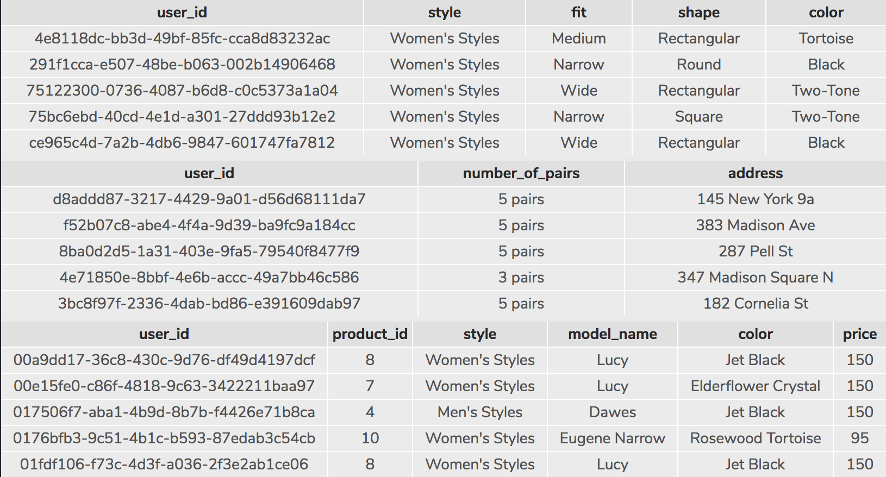
Query:
Results:
From doing this exercise, I see that every table has one column in common: user_id. We’re now going to use a series of left joins to merge the three different tables using the user_id column. We use a left join specifically because it allows us to keep all information even if some values are null.

Slide 14
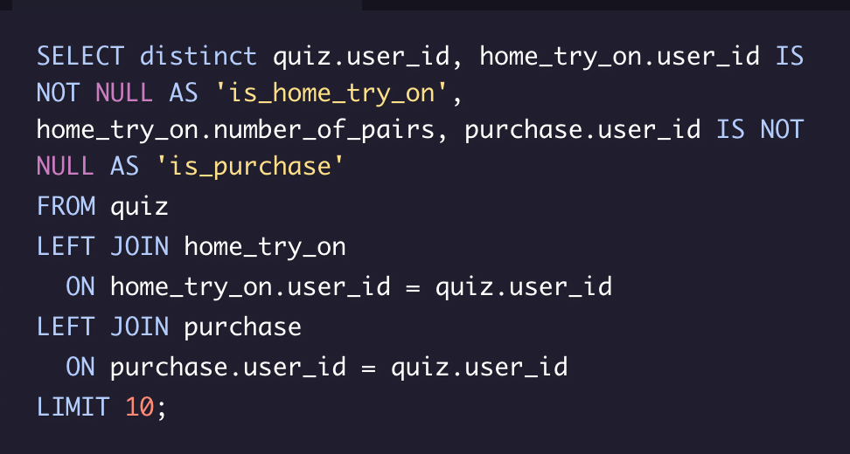
3.3 Merging Tables
Here’s the query I used to merge these tables using their matching user_id columns:
And the results….
This SELECT statement allows me to retrieve the following columns:
The user id of everyone who took the Quiz
Whether or not that user did the Home Try-On
How many glasses he/she tried on
If that user made a purchase or not
These are my left joins on the common user_id columns
I am retrieving only 10 rows so that the results will load quickly

Slide 15
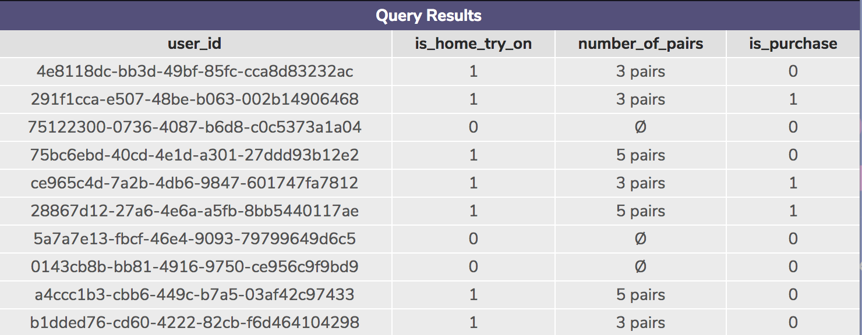
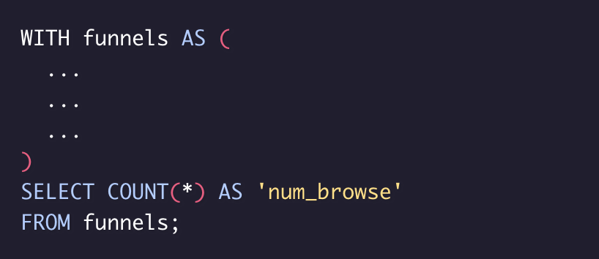
This is our merged table of the Quiz, Home Try-On, and Purchase steps of the Home Try-On Funnel which we can nickname “Funnels”. I can take this new table and use it to deduce new insights like conversion rates between the steps. We just need to use a With statement like so, and we can write some more queries from this table:

Slide 16
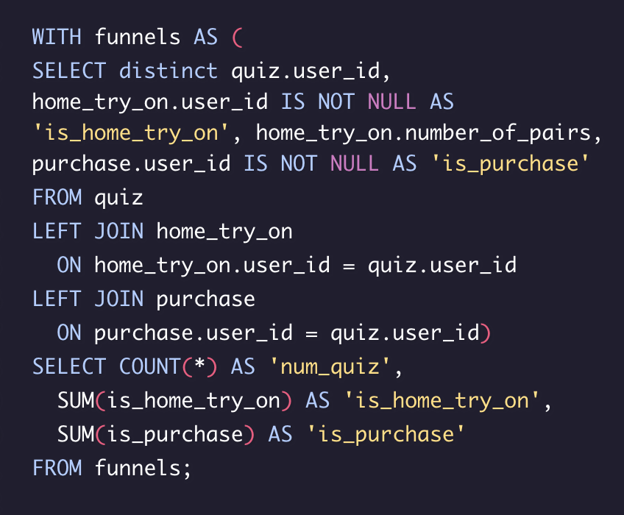
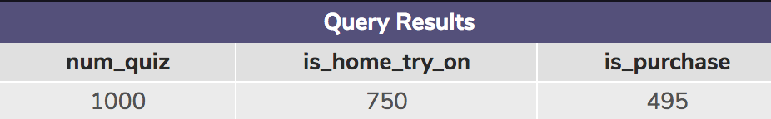
3.4 Calculating Conversion Rates
Here’s the query I used for calculating the conversation rate
between funnel stages:
And here is the result:
This is the table that we just merged!
750 divided by 100
495 divided by 750
Conversion Rate from Quiz to Home Try-On: 75%
Conversion Rate from Home Try-On to Purchase: 66%
This SELECT statement will show us how many users completed each step of the funnel.

Slide 17
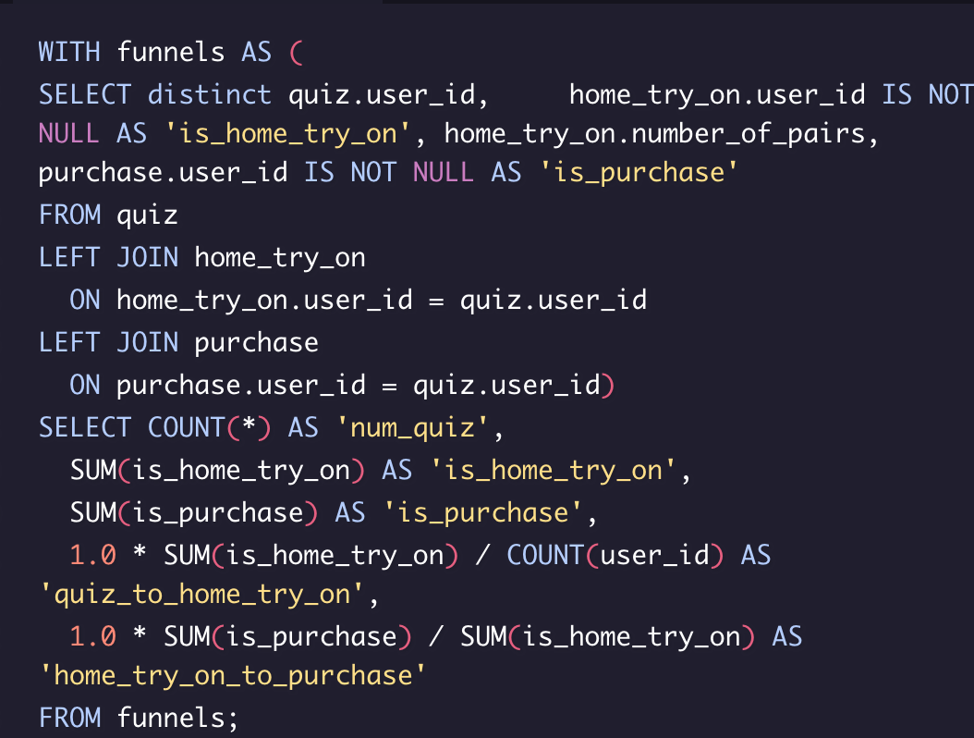
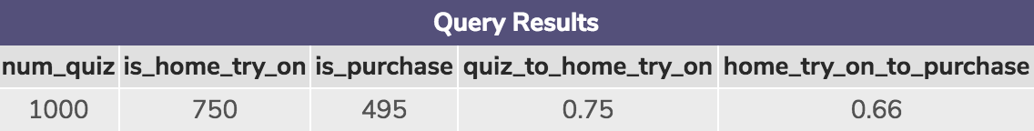
3.4 Calculating Conversion Rates (continued)
Now in the previous slide, I did the math to find the conversion rates manually, but I can actually use a query to do the math for me if I add in two additional columns like so:
…and got the same answer as I did on the previous slide!
I added this part to the SELECT statement…

Slide 18
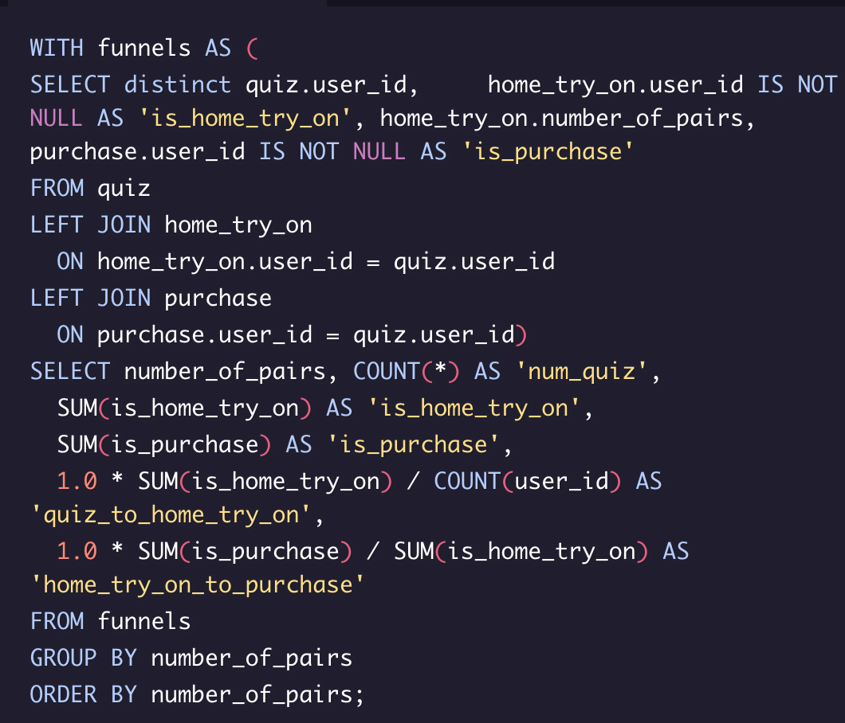
3.5 A/B Test Results…. Finally
It’s great that I found the overall conversion rates, but I still don’t know the difference between the users who tried on 3 pairs of glasses at home and users who tried on 5 pairs of glasses at home. Now that I’ve gotten this far, all I just need to use a GROUP BY statement so I can clearly see the conversion rates per number of glasses tried on at home.
I added number_of_pairs to the SELECT statement
Here is my GROUP BY statement followed by an ORDER BY statement! The latter statement just means the results will show in order.

Slide 19
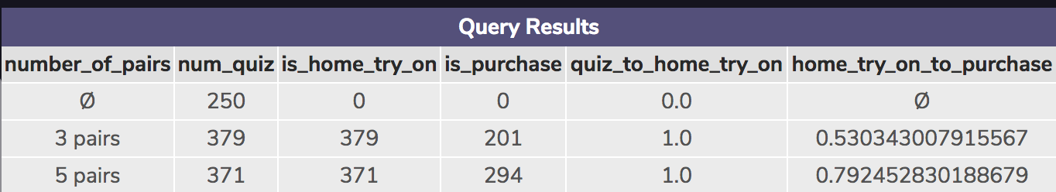
And finally…. when I ran my query, I got these results!
Results:
Final Analysis:
The obvious winner of our A/B Test is 5 pairs of glasses. Users were more likely to make a purchase if they tried on 5 pairs of glasses at home as opposed to 3 pairs of glasses. In fact, they were 26% more likely to make a purchase. This is clear evidence that Warby Parker should switch to allowing users to try on 5 pairs of glasses at home after taking the style quiz. The extra shipping cost is probably minimal, and the revenue increase will certainly be there. I personally agree with the findings, because when I go to a glasses store I have try on ALL the glasses to find the perfect pair!
This is just one great example of how SQL can be used to analyze data and help businesses stay informed of their customers’ needs and wants. I feel like this course gave me a great stepping stone into the world of SQL and data analysis. Thank you to everyone who contributed to this course and giving me this opportunity to learn something valuable. My journey has just begun!
Conversion Rates:
3 Pairs: 53%
5 Pairs: 79%

